Slide 1

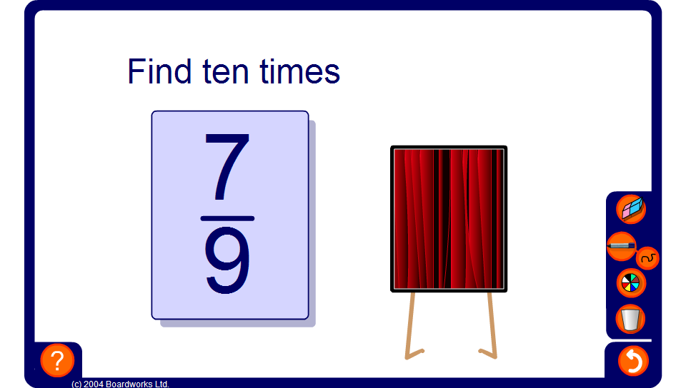

Multiplying and dividing fractions
Notes:
Ask pupils to answer each problem working mentally or using jottings before revealing the solution behind the curtains.

